Slide 1

Robot Data Visualization
Presented By: Ray Adler, Ken Latimer, Robin Li, and Hao Wu
CSE 583 - Robot Data Visualization Team
Notes:
Presented By: Ray

Slide 2
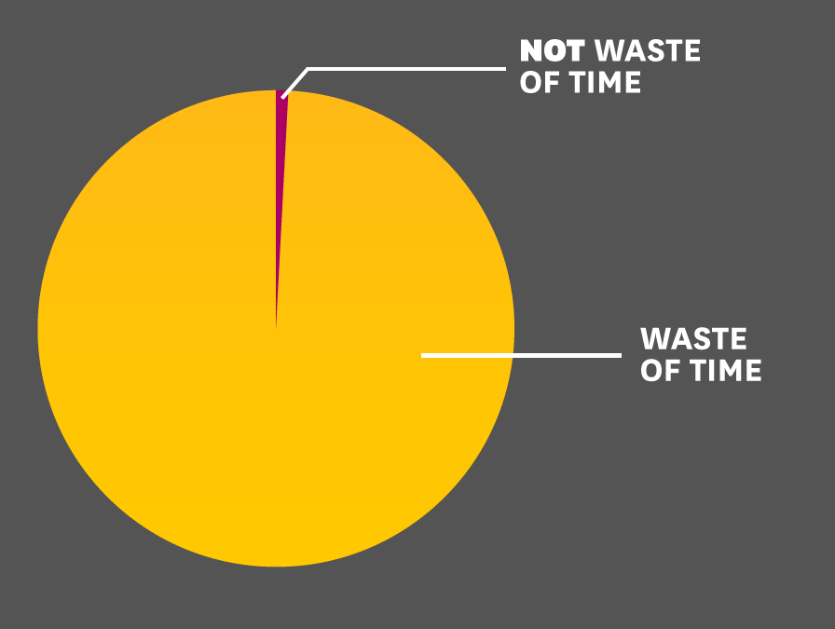
Motivation & Solution
Motivation: Robot data is difficult to work with!
Difficult to interpret and data sets are large
A lot of time is spent processing data:
Reformatting
Visualizing
This time could be spent furthering research!
Solution: Create a tool that allows roboticists to easily access and visualize robot data
CSE 583 - Robot Data Visualization Team
Notes:
Presented by Ray

Slide 3
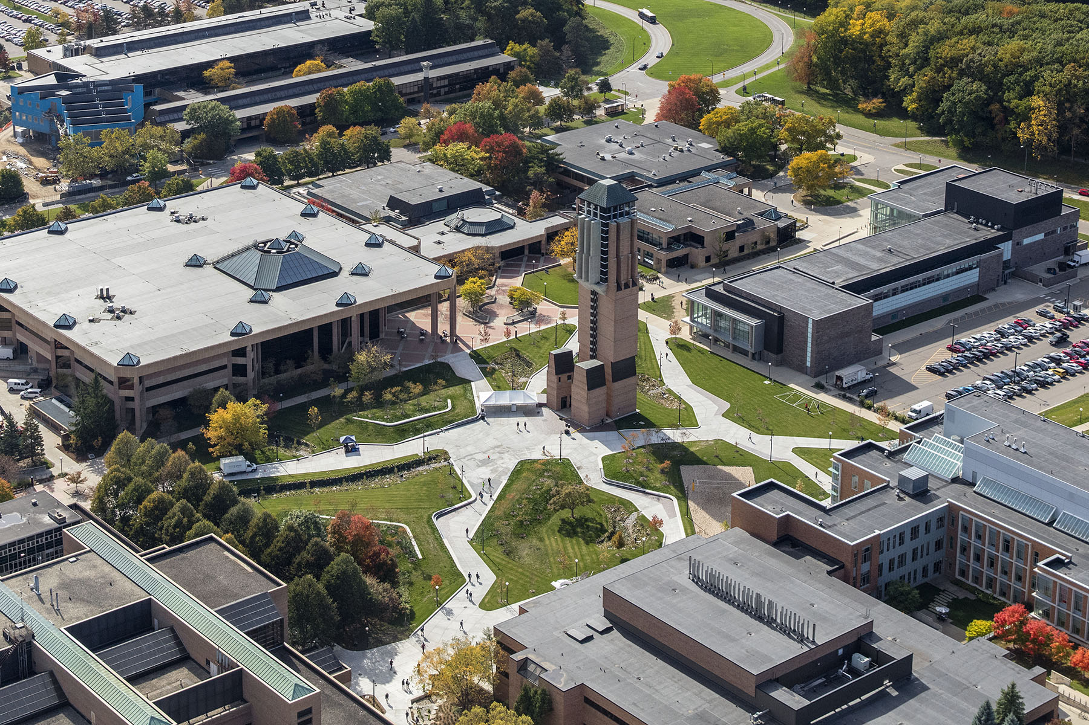
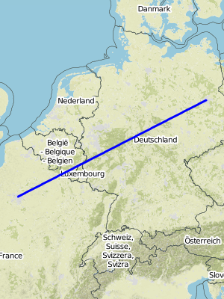
Data Sources
The University of Michigan North Campus Long-Term Vision and LIDAR Dataset.
GPS
LIDAR
staticmap API
Map Overlay that provides street and landmark data
https://rpm.engin.umich.edu/facilities/north-campus-photos/
https://github.com/komoot/staticmap
CSE 583 - Robot Data Visualization Team
Notes:
Presented by Hao
First is from UMichi. And we choose Long-Term Vision and LIDAR Dataset.
Second is staticmap API. For which we can generate a map overlay that provides street and landmark data which can make the meaningless gps more readable.

Slide 4
Tool Requirements
Requirement 1: Download and Condition Data
Requirement 2: Robot Path Visualization
Requirement 3: Visualize Robot Environment
Requirement 4: Accessible User Interface
CSE 583 - Robot Data Visualization Team
Notes:
Presented by Robin
In order to realize the whole function, we need 4 tools overall. The first tool is used to download and present some preprocessing to our dataset. The second one is to plot the path of the robot on a map, using the GPS data and the staticmap API. Our next tool is for visualizing the surroundings of the robot from the lidar data. Also, in this part of the code we can get the precise location of the robot. The last requirement is having a user interface for quick visualization of the dataset.

Slide 5
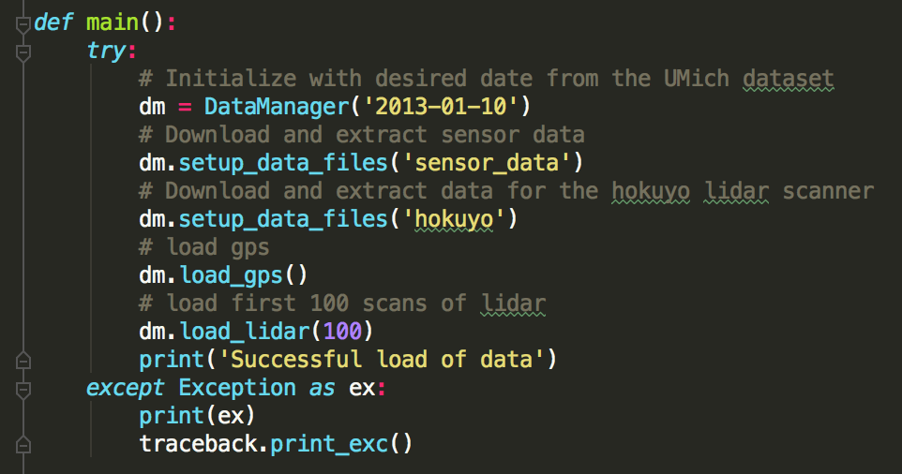
Requirement 1: Download and Condition Data
DataManager Module
CSE 583 - Robot Data Visualization Team
Notes:
Presented by Robin
Our data manager is the first step of manipulating the data sets.
It downloads the robotic datasets including GPS, Hokuyo Lidar data from websites and unzip them. After that we need to filter the GPS data because some of them has nan inside and couldn’t be use for trajecting the robot location.Next we transfer the original GPS data which is in the radius magnitude in to longitude and latitude. This is for the static map plotting. Finally we will handle the binary file generated by the Lidar data and show several scans of the sensor.

Slide 6
Requirement 2: Visualize Robot Path
GPS and Map Overlay Module
Get data from DataManager
Subsample GPS data
Use staticmap API
Problem here:
API can only generate picture full with line features
But we need to see path real-time
How to solve?
Override API to extract image with no features
Extract line features
Use matplotlib to plot with line features
CSE 583 - Robot Data Visualization Team
Notes:
Presented by Hao
-The reason to subsample GPS data is that the dataset is too large, and the time interval is very small, there is no need to enlarge the workload of computing.
-Mention how applying the map overlay provides familiar, real-world context for the data. For instance, in our program, we overlay gps data on a map. The map contextualizes the data by providing references for landmarks, street names and other geographic references.

Slide 7
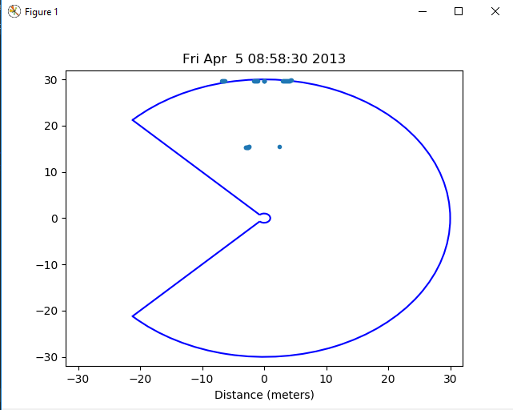
Requirement 3: Visualize Robot Environment
LIDAR Module
Provides a LIDAR scan of what the robot sees
Thresholds and removes erroneous values that are too close to the robot
Overlays a bounding region showing limits of LIDAR scanner
Outputs timestamp
CSE 583 - Robot Data Visualization Team
Notes:
Presented by Ray:
By taking successive lidar scans and calculating the differences between points, the robot position and orientation (pose) can be backed out from the natural misalignment of points that occurs when recording lidar scans from a moving robot

Slide 8
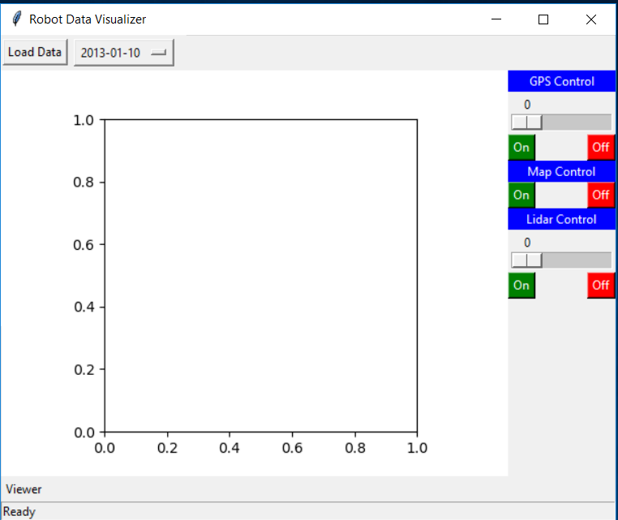
Requirement 4: Accessible User Interface
Graphical User Interface
Built using the Python tkinter module
Controls
Load Data
Map On/Off
GPS On/Off with a slider
Lidar On/Off with a slider
Viewing window for user selection of data.
CSE 583 - Robot Data Visualization Team
Notes:
Presented by Ken
Built with tkinter
Comes with Python, no additional installation required.
Controls – load data, gps, map, lidar
Based on user selection, these are displayed in the viewer.

Slide 9
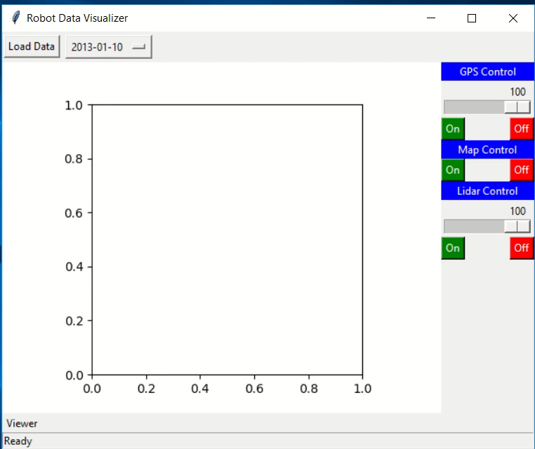
Demo
CSE 583 - Robot Data Visualization Team
Notes:
Presented by Ken
Status bar shows “Ready”
Load Data pressed
Status – data is ready
User can change GPS slider, turn map on and off, or switch to the lidar viewing mode.
Dropdown allows different dates to be selected from the dataset
Other selection made – new data loaded
Again, user can change GPS slider, turn map on and off, or switch to the lidar viewing mode.

Slide 10
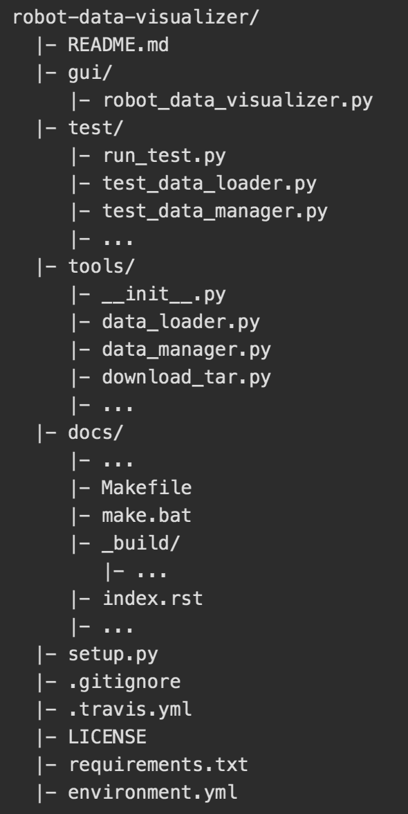
Repository Features
Auto docs (Sphinx)
Tests (Travis-CI)
Intuitive GUI
CSE 583 - Robot Data Visualization Team
Notes:
Presented by Ken

Slide 11
Future Work
Additional Functionality:
Visualize Odometry Data
Determine Robot Pose
Overlay Lidar on Map

Slide 12

Questions?
CSE 583 - Robot Data Visualization Team

